Slide 1
SlidesCarnival
August 19, 2024
Insights from the Stack Overflow Developer Survey
A Data‑Driven Analysis of Future Tech Trends

Slide 2
OUTLINE
Executive summary
Introduction
Methodology
Results
Visualization – charts
Dashboard
Discussion
Findings & implications
Conclusion
Appendix

Slide 3

EXECUTIVE SUMMARY
The analysis of the Stack Overflow Developer Survey highlights several important trends shaping the developer landscape. Python and JavaScript continue to dominate across age groups, while cloud‑native databases are gaining traction as organizations modernize their infrastructure.
Younger developers show high participation rates but report lower satisfaction, whereas mid‑career professionals demonstrate stronger retention and more positive engagement indicators.
These findings carry clear implications for stakeholders. Organizations can use them to refine talent strategies, educators can align curricula with emerging technologies, and communities can better support developer well‑being.
By anticipating shifts in language adoption and database preferences, decision‑makers are positioned to foster engagement, improve retention, and prepare for the future of technology.

Slide 4

INTRODUCTION
The Stack Overflow Developer Survey provides one of the most comprehensive views into the global developer community, capturing insights into technologies, work preferences, and demographic trends.
Analyzing this dataset offers a unique opportunity to understand not only which tools and languages are most widely adopted, but also how satisfaction, participation, and career trajectories vary across different groups.
This project applies a structured data analysis workflow — beginning with acquisition and preparation of the raw survey data, followed by exploratory analysis to uncover distributions and relationships. Patterns are identified through statistical techniques and visual exploration, and findings are communicated through clear, professional visualizations.
Ultimately, the goal is to interpret these results in a way that highlights meaningful trends in developer engagement and provides actionable insights for organizations, educators, and communities invested in the future of technology.

Slide 5

METHODOLOGY
Data Acquisition → Download Stack Overflow Developer Survey dataset.
Data Preparation → Clean missing values, standardized categories, map text responses to numeric codes.
Exploratory Data Analysis (EDA) → Use Python, SQL, and Excel to explore distributions and relationships.
Pattern Identification → Cross‑tabulated variables, correlation analysis, bubble plots, clustering.
Visualization → Create clear, consistent charts with professional colour palettes.
Interpretation → Highlight developer trends in participation, satisfaction, and demographics.

Slide 6
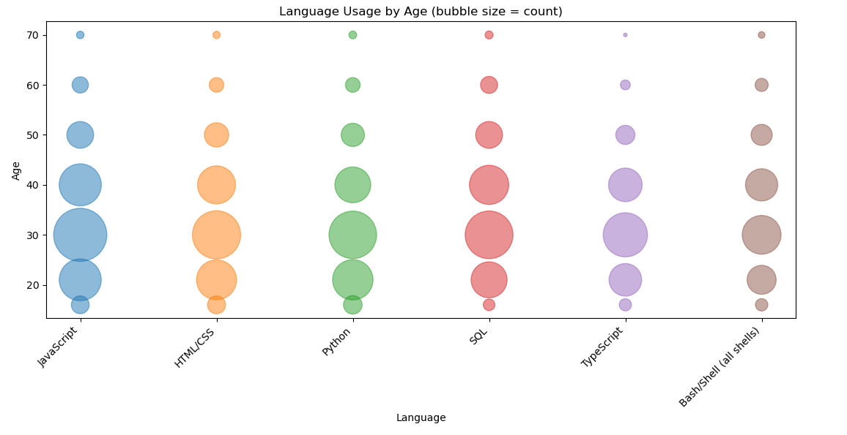
Language Usage by Age

Slide 7
What this means?
Concentration in younger ages → Most of the large bubbles cluster between ages 20–40, meaning the bulk of developers using JavaScript, HTML/CSS, Python, SQL, TypeScript, and Bash are in that younger to mid‑career range.
Language popularity by age → JavaScript, Python, and SQL have consistently large bubbles across multiple age bands, showing broad adoption. TypeScript and Bash/Shell appear more niche, with smaller bubbles overall.
Drop‑off with age → Bubble sizes shrink noticeably after age 40–50, indicating fewer older developers are represented in the survey or actively using these languages.
Generational trends → Python’s strong presence among younger developers suggests it’s a preferred entry language, while SQL and JavaScript remain staples across all ages.

Slide 8
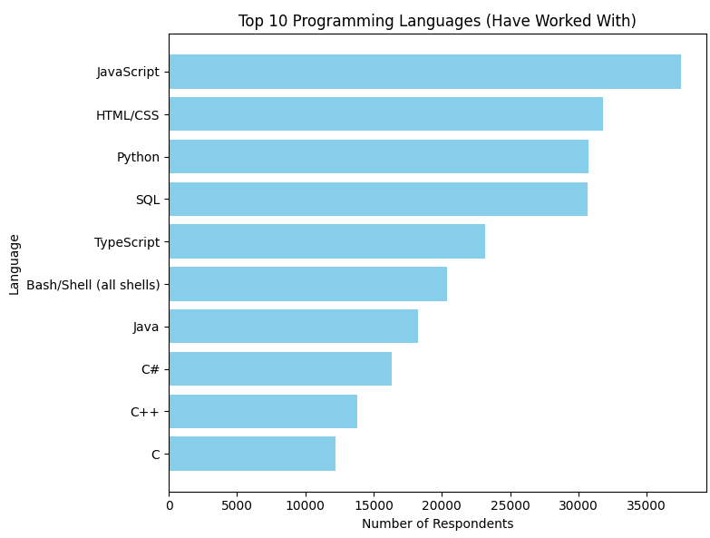
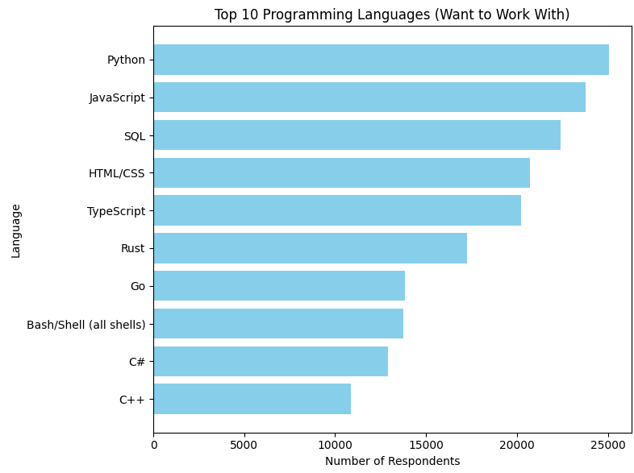
PROGRAMMING LANGUAGE TRENDS
Current year
Next year

Slide 9
What this means?
Stable leaders → JavaScript, Python, and SQL dominate both charts. They’re widely used now and remain highly desired for the future, confirming their central role in development.
Shifting interest → Python moves to the very top in “want to work with,” showing strong momentum among developers who may not yet use it but aspire to.
Emerging languages → Rust and Go appear in the “next year” chart but not in the current top 10. This signals growing curiosity and adoption potential, especially among developers looking for modern, efficient systems languages.
Declining appeal → Older staples like Java and C are strong in current usage but drop off in future interest, suggesting they’re seen as legacy skills rather than aspirational ones.
Consistency in web stack → HTML/CSS and TypeScript remain important across both charts, reflecting the continued dominance of web development.

Slide 10
PROGRAMMING LANGUAGE TRENDS: FINDINGS & IMPLICATIONS
Findings
Python and JavaScript dominate both current usage and future interest, confirming their role as core developer skills.
Rust and Go emerge in “want to work with,” signaling growing adoption of modern, efficient languages.
Legacy languages like Java and C remain widely used but show declining appeal in future preferences.
Implications
Organizations should prioritize Python and JavaScript expertise when hiring and training, as they remain essential across industries.
Educators and training providers can incorporate Rust and Go into curricula to prepare developers for upcoming demand.
Companies relying heavily on Java or C should plan for gradual skill transitions, balancing legacy system support with modern language adoption.

Slide 11
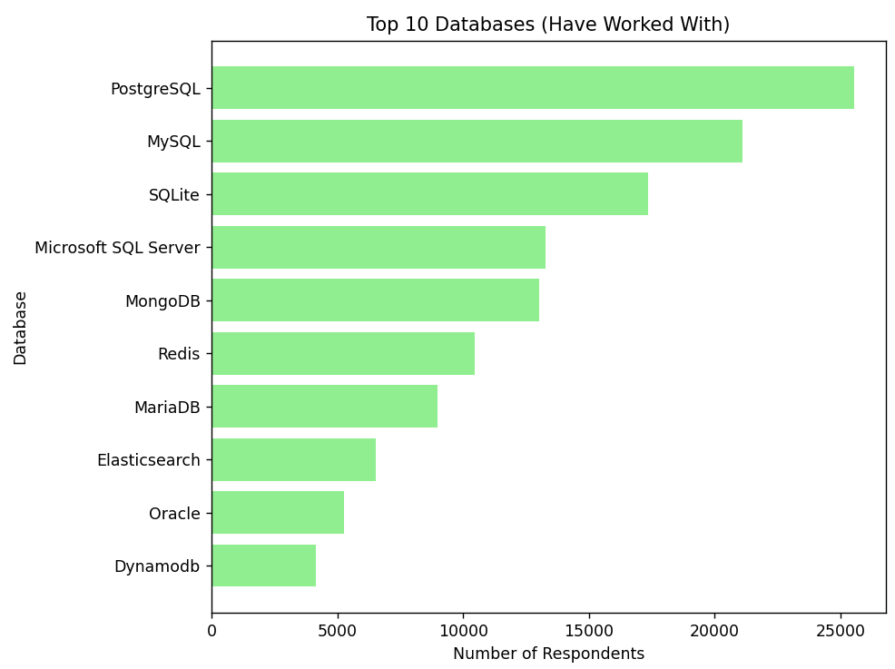
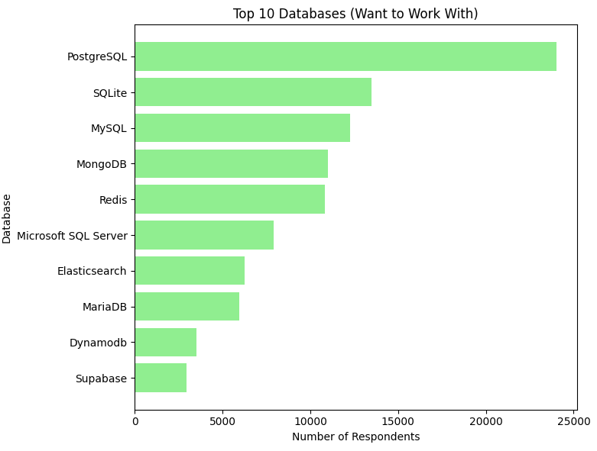
DATABASE TRENDS
Current year
Next year

Slide 12
What this means?
PostgreSQL’s dominance → It’s already the most widely used database and also the most desired for future work. That signals strong momentum and industry confidence in its scalability and modern features.
MySQL slipping → While still heavily used today, it drops behind PostgreSQL and SQLite in future interest, suggesting developers see it more as a legacy tool.
SQLite’s rise → It’s third in current usage but jumps to second in “want to work with,” reflecting its appeal for lightweight, embedded applications and rapid prototyping.
Cloud‑native and modern options → MongoDB, Redis, and Supabase (appearing only in future interest) show developers are increasingly drawn to flexible, cloud‑friendly solutions.
Enterprise databases fading → Oracle and Microsoft SQL Server remain in the current top 10 but lose ground in future preferences, indicating declining enthusiasm outside legacy systems.

Slide 13
DATABASE TRENDS: FINDINGS & IMPLICATIONS
Findings
PostgreSQL has overtaken MySQL as the most widely used and most desired database, consolidating its lead.
SQLite shows strong growth in future interest, rising to second place in “want to work with.”
Legacy enterprise databases like Oracle and Microsoft SQL Server remain common today but are losing appeal in future preferences.
Implications
Organizations should invest in PostgreSQL expertise and migration strategies to align with industry momentum.
Educators and training providers can emphasize lightweight solutions like SQLite to prepare developers for modern application needs.
Companies relying on legacy databases must plan for gradual transitions, balancing system stability with adoption of cloud‑native and developer‑preferred platforms.

Slide 14
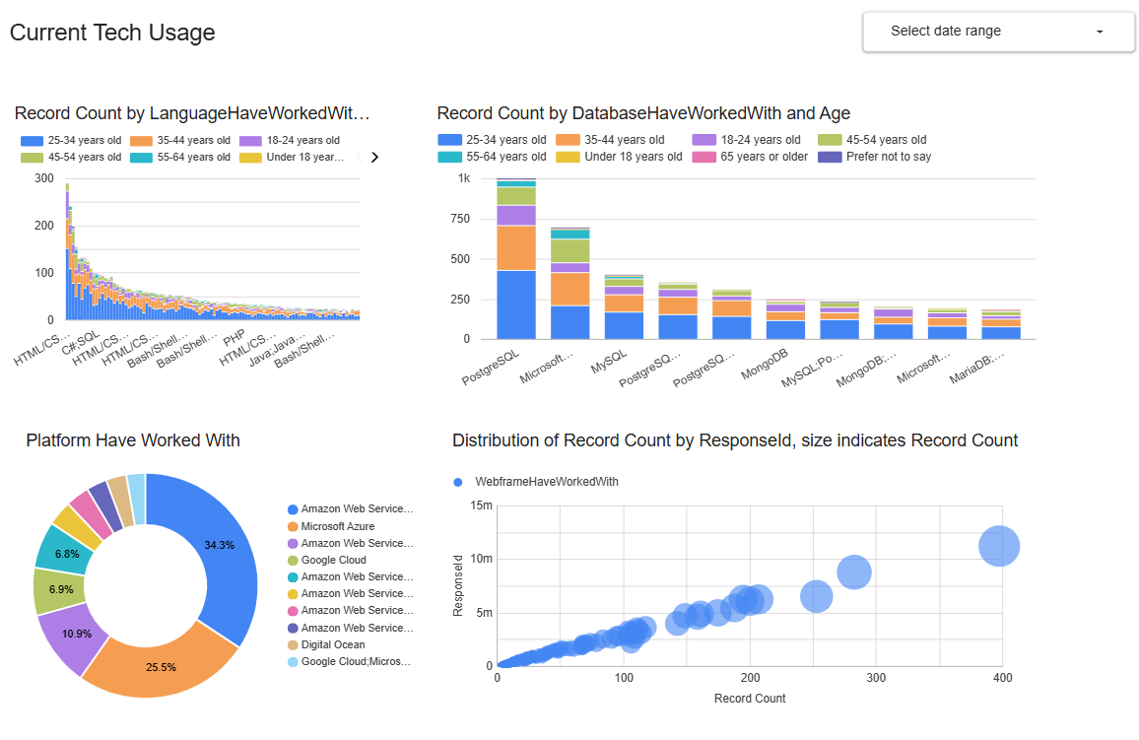
DASHBOARD
Current Tech Usage → Bar charts break down programming languages and databases by age group, showing generational differences in adoption.

Slide 15
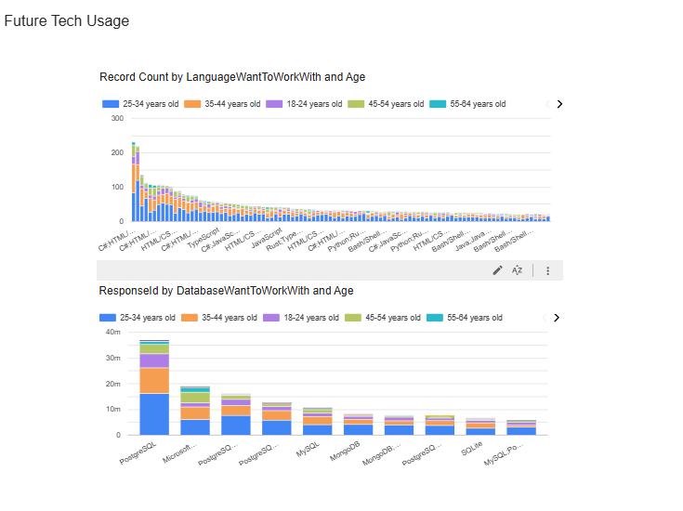
Future Tech Usage → Charts highlight what developers want to work with, revealing aspirational trends (e.g., Rust, PostgreSQL, AWS).

Slide 16
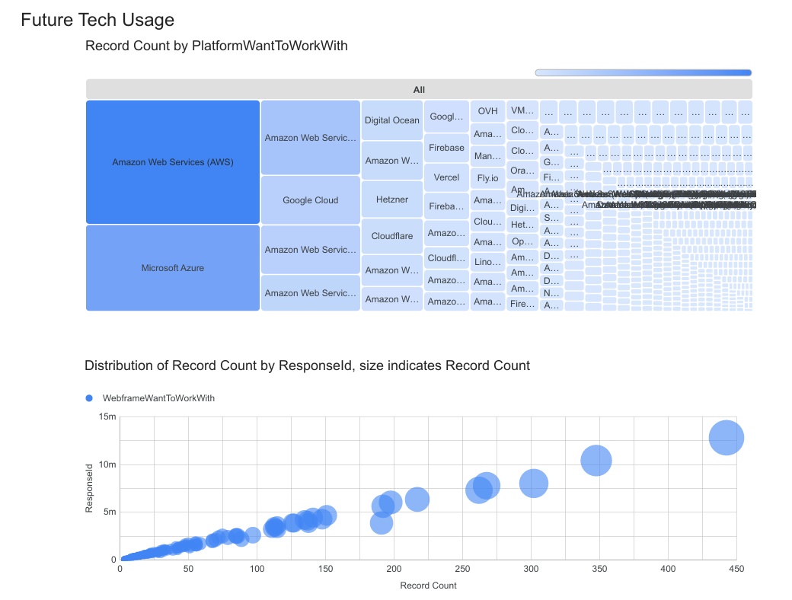
Platforms → Pie charts and heatmaps compare cloud providers (AWS, Azure, Google Cloud), showing market share and developer interest

Slide 17
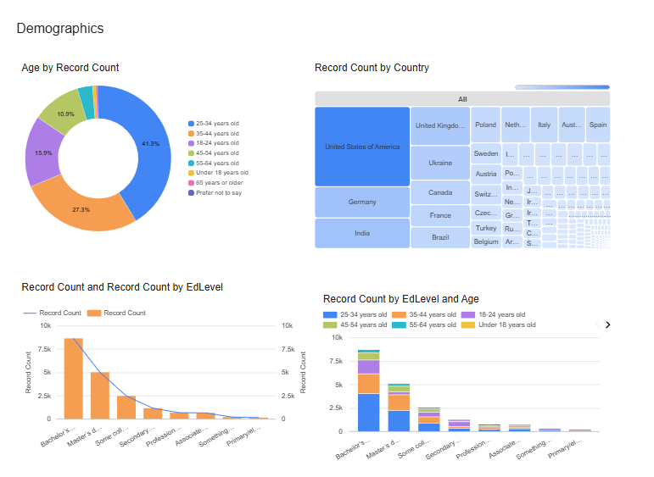
Demographics → Donut charts and treemaps give context: age distribution, education levels, and country representation, helping interpret trends in light of who’s responding

Slide 18

DISCUSSION
The ecosystem is consolidating around Python and PostgreSQL, while developer aspirations point toward modern languages and cloud‑native solutions.
The dashboard transforms these raw survey results into actionable insights for organizations, educators, and communities.

Slide 19

CONCLUSION
Python, JavaScript, and SQL remain foundational, while Rust and Go signal the next wave of developer interest.
PostgreSQL has emerged as the leading database, with SQLite gaining momentum and legacy systems losing appeal.
The dashboard provides a holistic view of current and future tech usage, demographics, and platforms, turning raw survey data into actionable insights.
Organizations, educators, and communities can leverage these findings to align strategies, curricula, and engagement with the evolving developer ecosystem.

Slide 20

APPENDIX
https://github.com/Brendan-Trollip/IBM-Data-Analysis-Labs.git

Slide 21
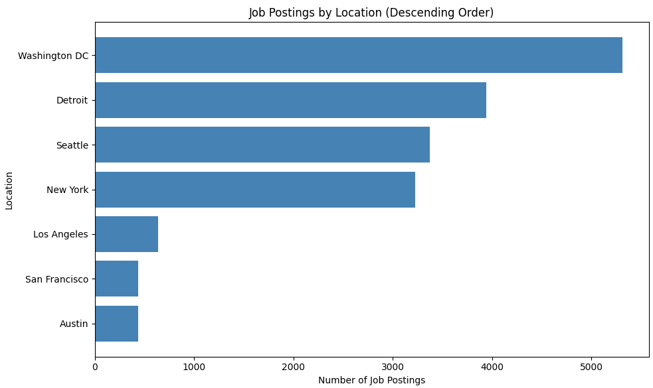
JOB POSTINGS

Slide 22
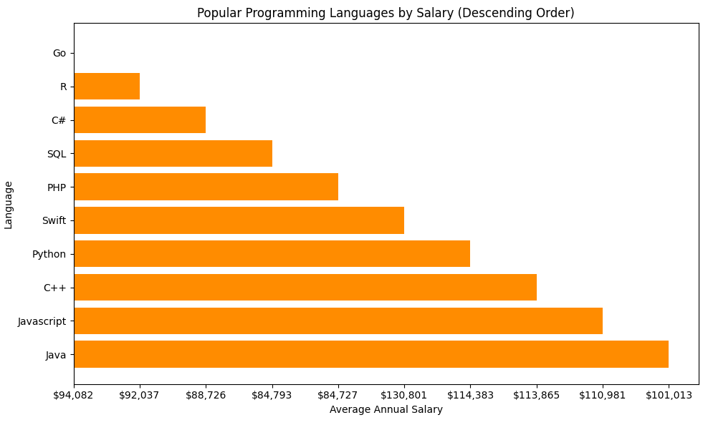
POPULAR LANGUAGES

